Slide 1

Introducing modelling
with R
Please download the presentation and script from :
https://github.com/dolivenca/introducing_modelling_with_R

Slide 2



The example model describes growth of bacteria (Bact) on a substrate (Sub) in a closed vessel

Slide 3
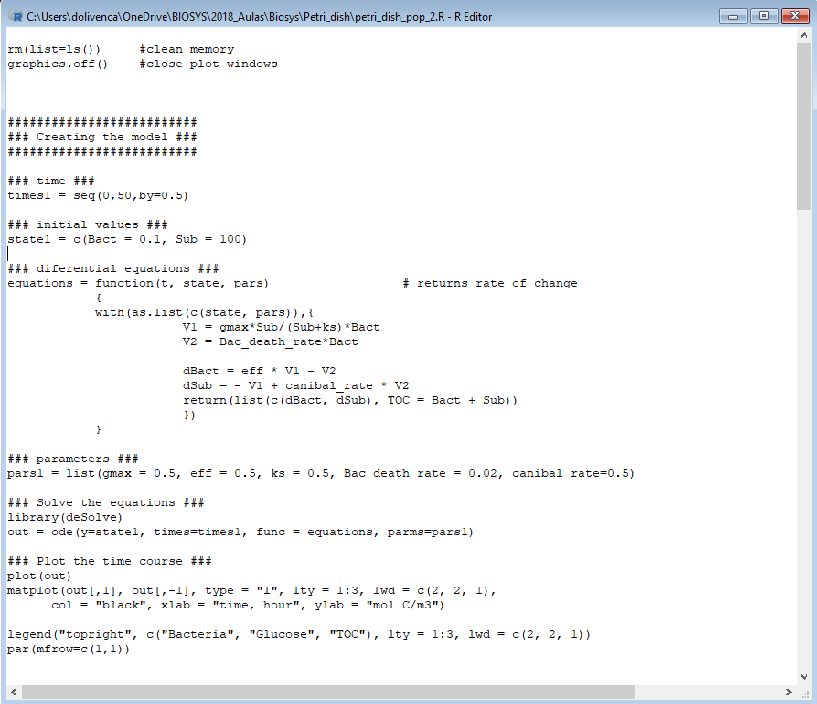


The example model describes growth of bacteria (Bact) on a substrate (Sub) in a closed vessel

Slide 4
The example model describes growth of bacteria (Bact) on a substrate (Sub) in a closed vessel

Slide 5
The example model describes growth of bacteria (Bact) on a substrate (Sub) in a closed vessel

Slide 6
The example model describes growth of bacteria (Bact) on a substrate (Sub) in a closed vessel

Slide 7
The example model describes growth of bacteria (Bact) on a substrate (Sub) in a closed vessel

Slide 8
The example model describes growth of bacteria (Bact) on a substrate (Sub) in a closed vessel
V2
Bact
Sub
V1

Slide 9
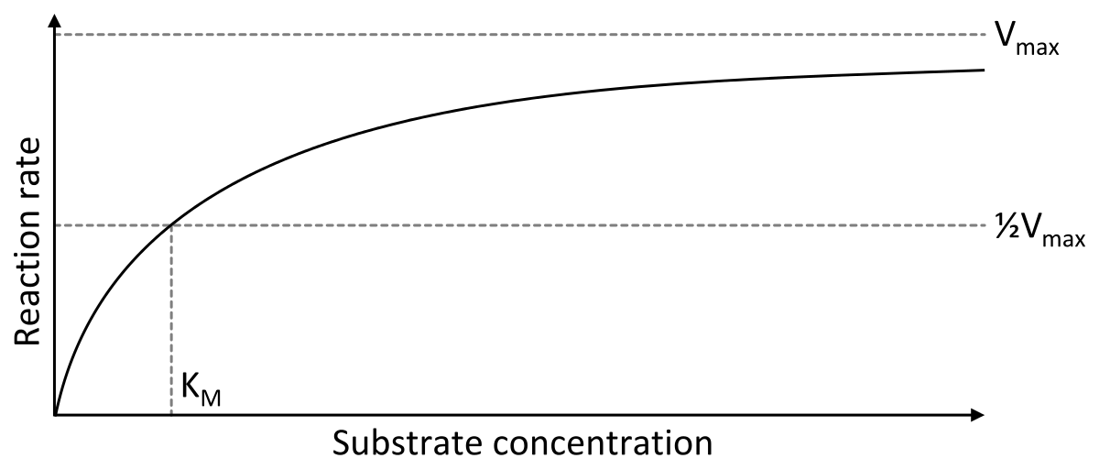
The example model describes growth of bacteria (Bact) on a substrate (Sub) in a closed vessel
V2
Bact
Sub
Michaelis–Menten equation
Hill equation
V1
Power-Law
n>1
n=1
Operating point (op)
V1 = gmax*Sub/(Sub+ks)*Bact
V2 = Bac_death_rate*Bact
dBact = eff * V1 - V2
dSub = - V1 + canibal_rate * V2

Slide 10
Michaelis–Menten equation
The example model describes growth of bacteria (Bact) on a substrate (Sub) in a closed vessel
V2
Bact
Sub
V1
V1 = gmax*Sub/(Sub+ks)*Bact
V2 = Bac_death_rate*Bact
dBact = eff * V1 - V2
dSub = - V1 + canibal_rate * V2

Slide 11
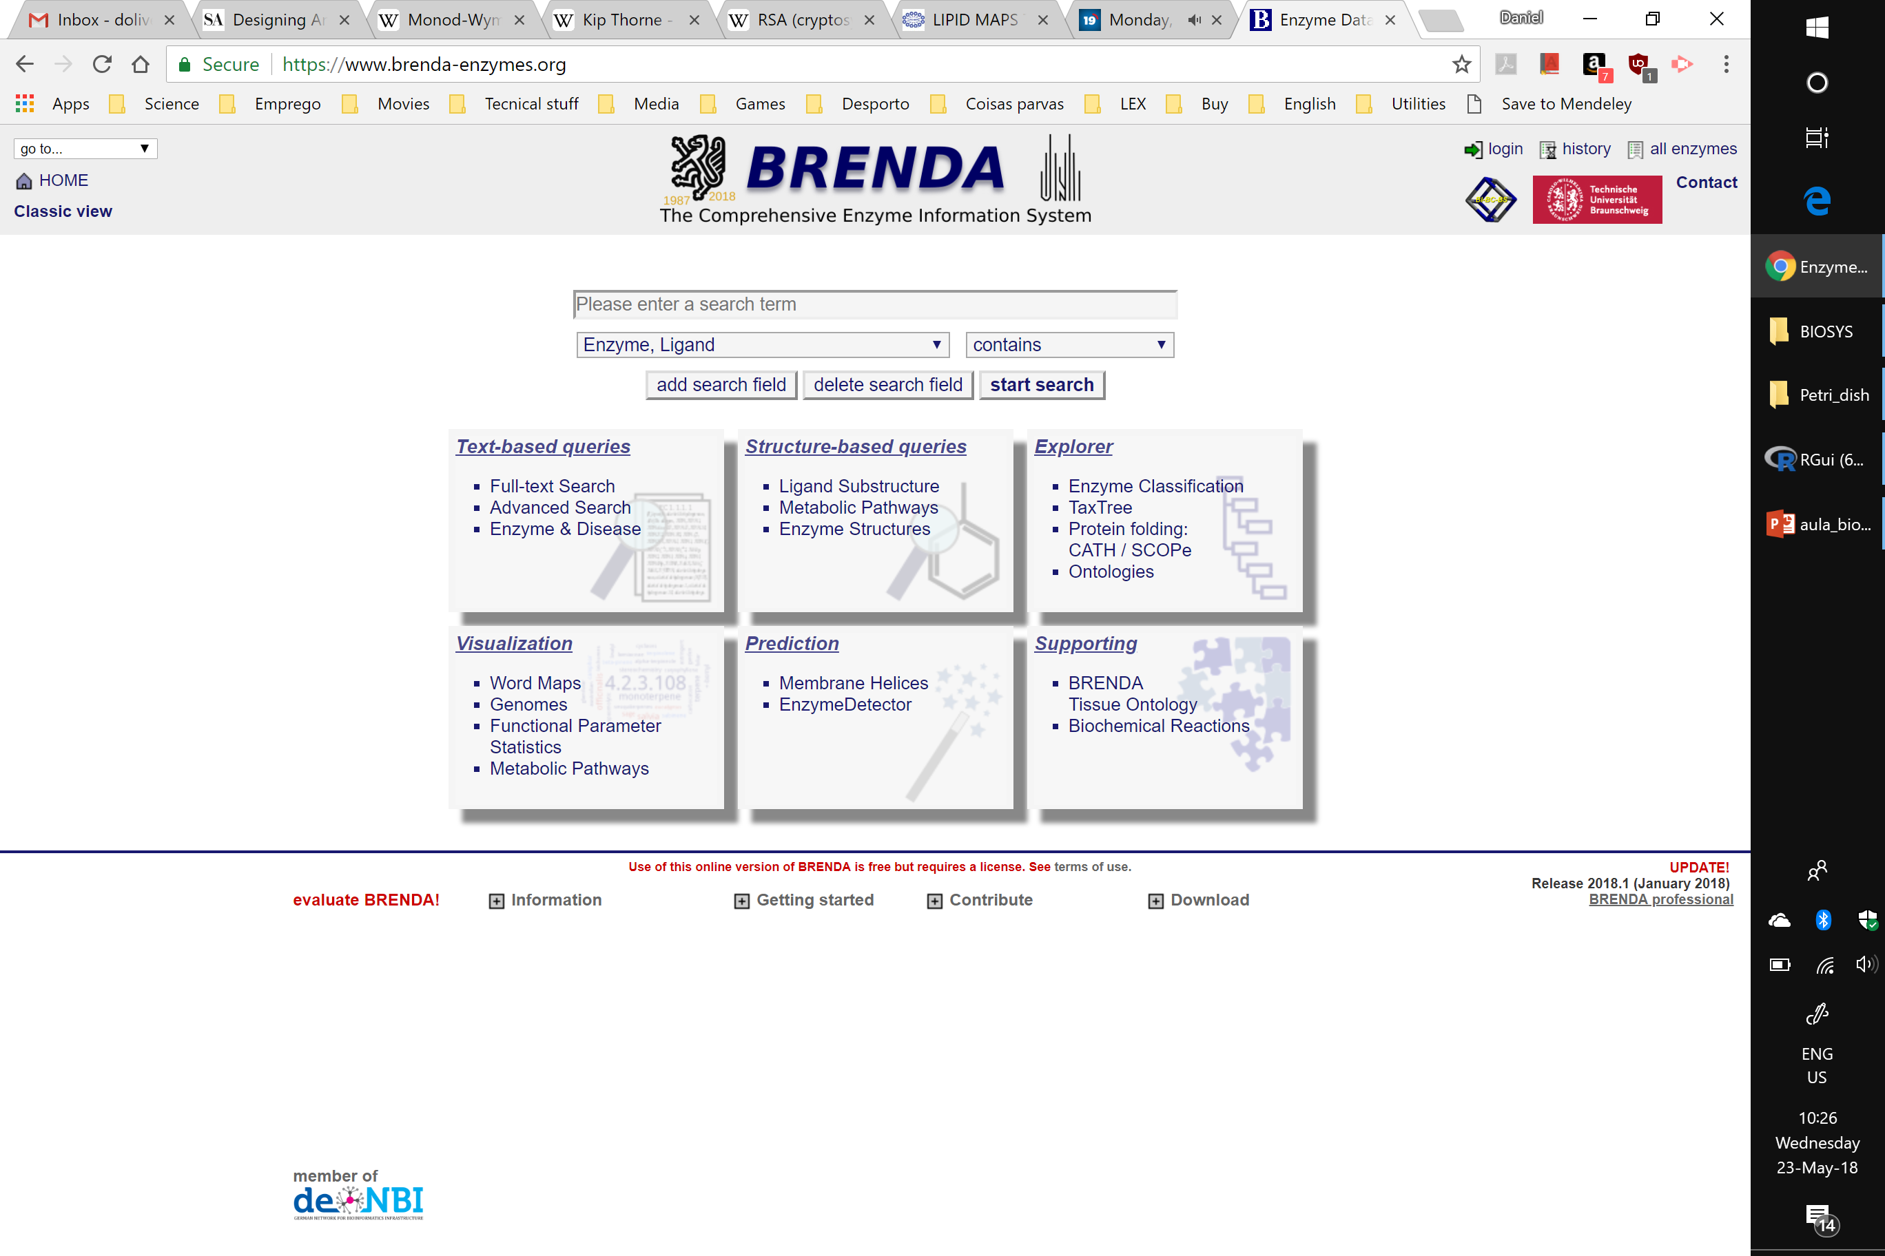

The example model describes growth of bacteria (Bact) on a substrate (Sub) in a closed vessel
V2
Bact
Sub
V1
V1 = gmax*Sub/(Sub+ks)*Bact
V2 = Bac_death_rate*Bact
dBact = eff * V1 - V2
dSub = - V1 + canibal_rate * V2

Slide 12
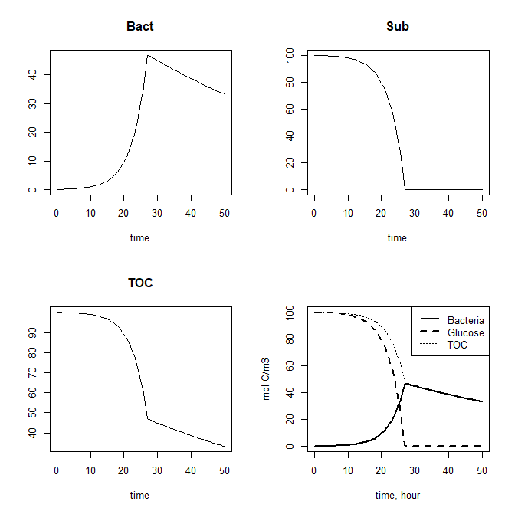
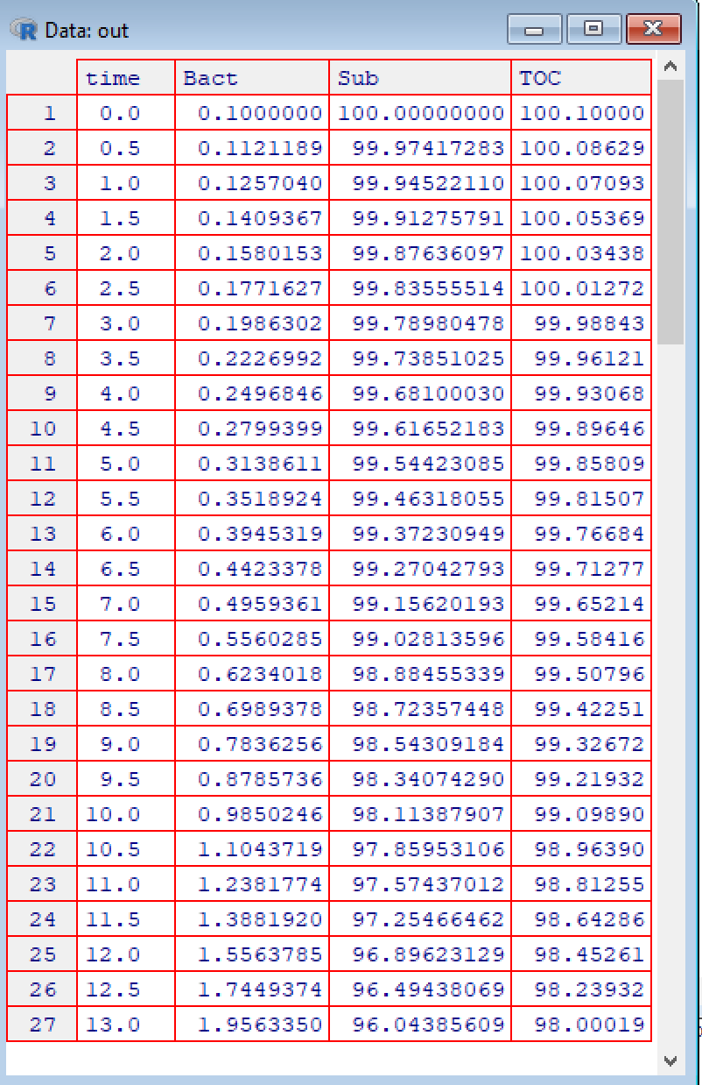
The example model describes growth of bacteria (Bact) on a substrate (Sub) in a closed vessel
V2
Bact
Sub
V1
V1 = gmax*Sub/(Sub+ks)*Bact
V2 = Bac_death_rate*Bact
dBact = eff * V1 - V2
dSub = - V1 + canibal_rate * V2

Slide 13
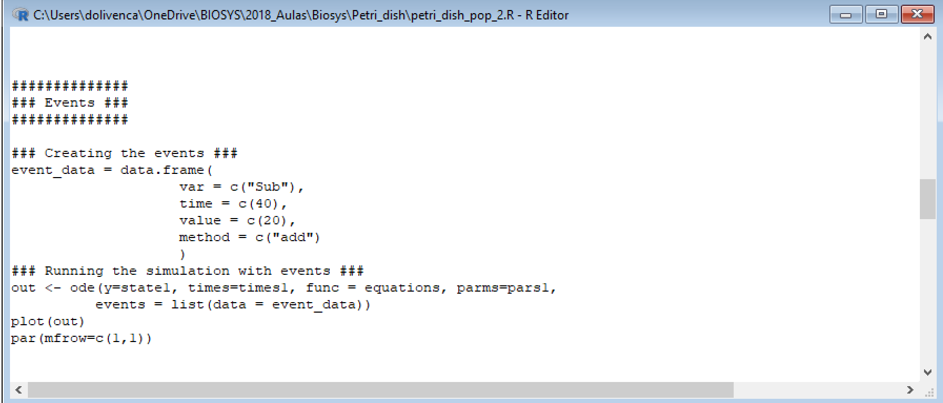
Events

Slide 14
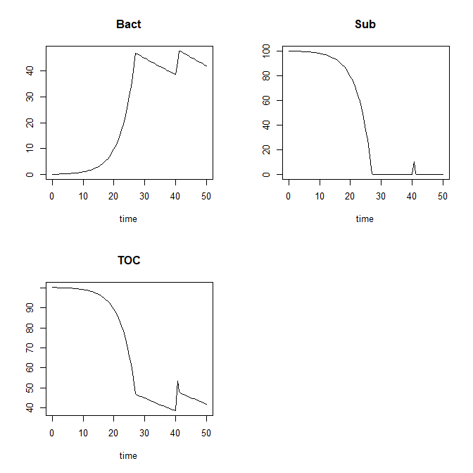
Events

Slide 15
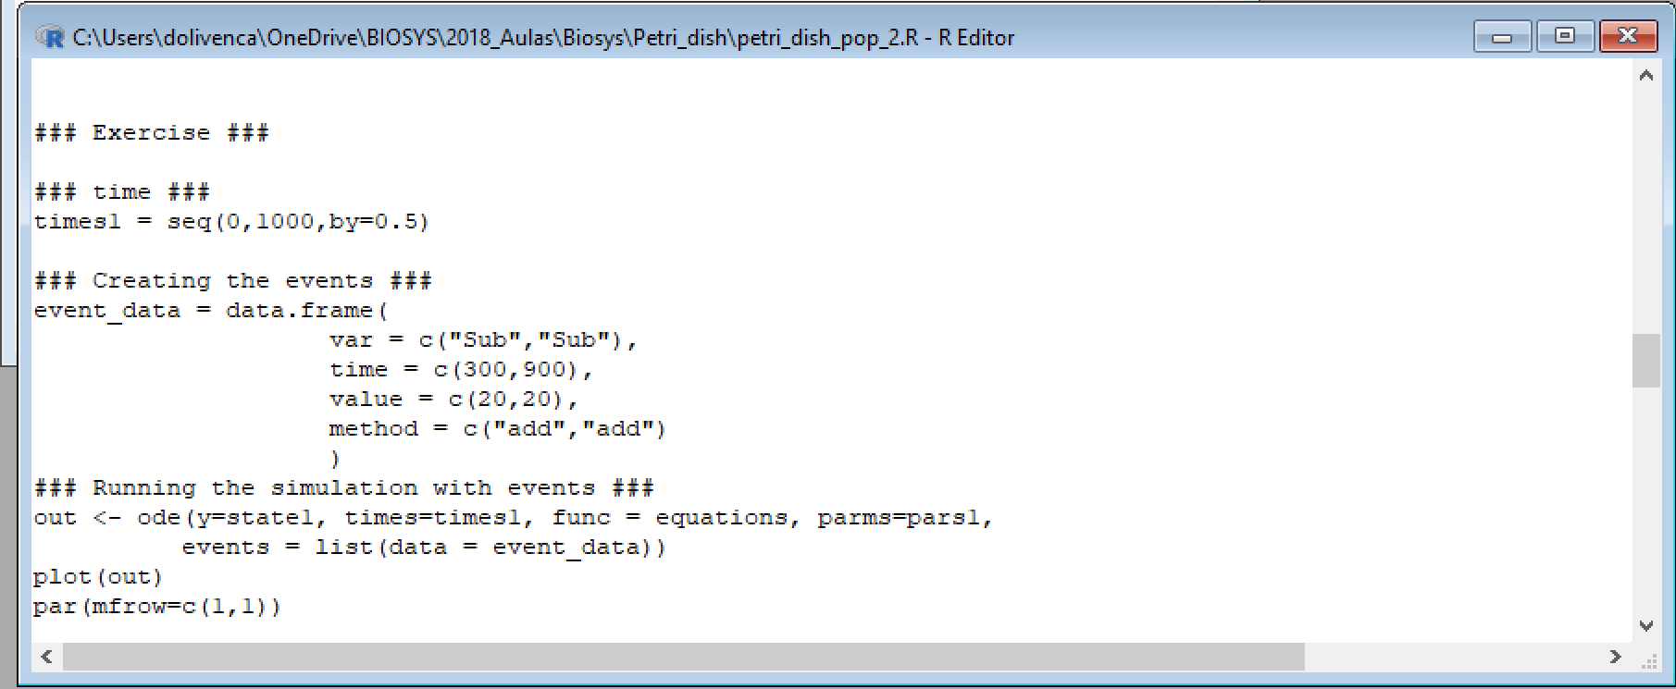
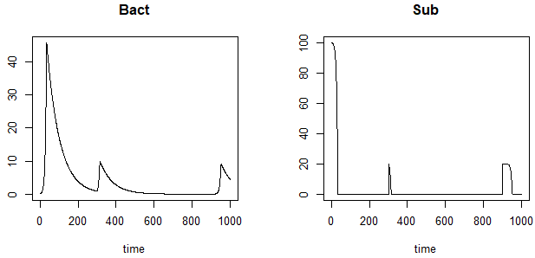
Events – Exercise
Increase the time of the simulation to 1000 hours.
Create 2 events:
First – at 300 hours add 20 mol of glucose to the solution.
Second – at 900 hours add 20 mol of glucose to the solution.
The pics in the Sub plot at time 300 and 900 are diferente. Why?

Slide 16
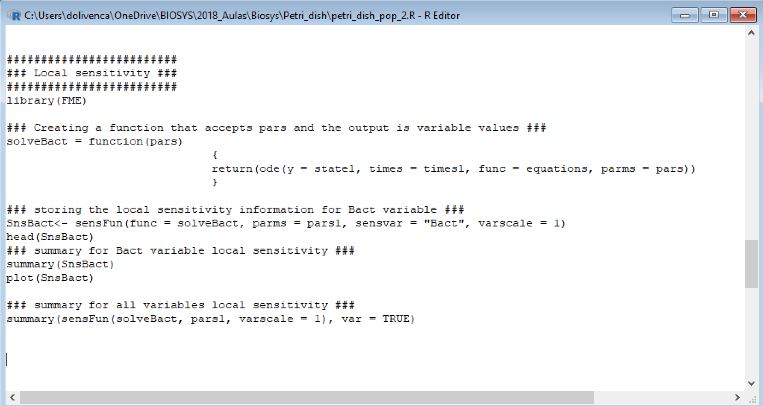
Local sensitivity

Slide 17
Local sensitivity

Slide 18
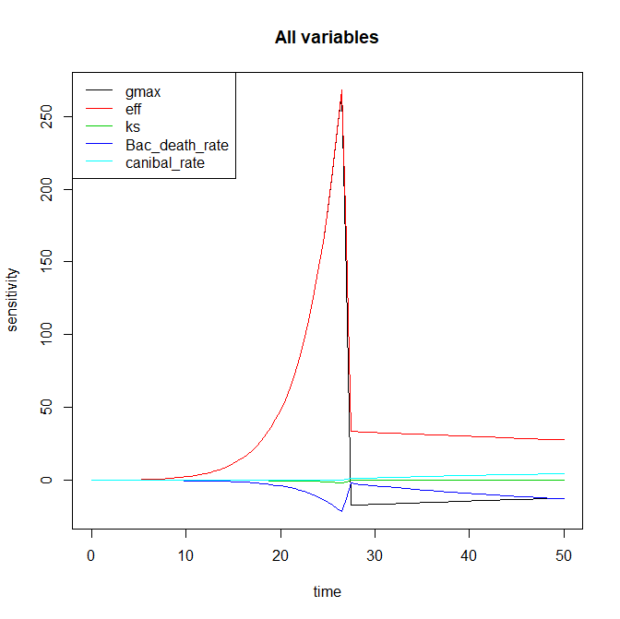
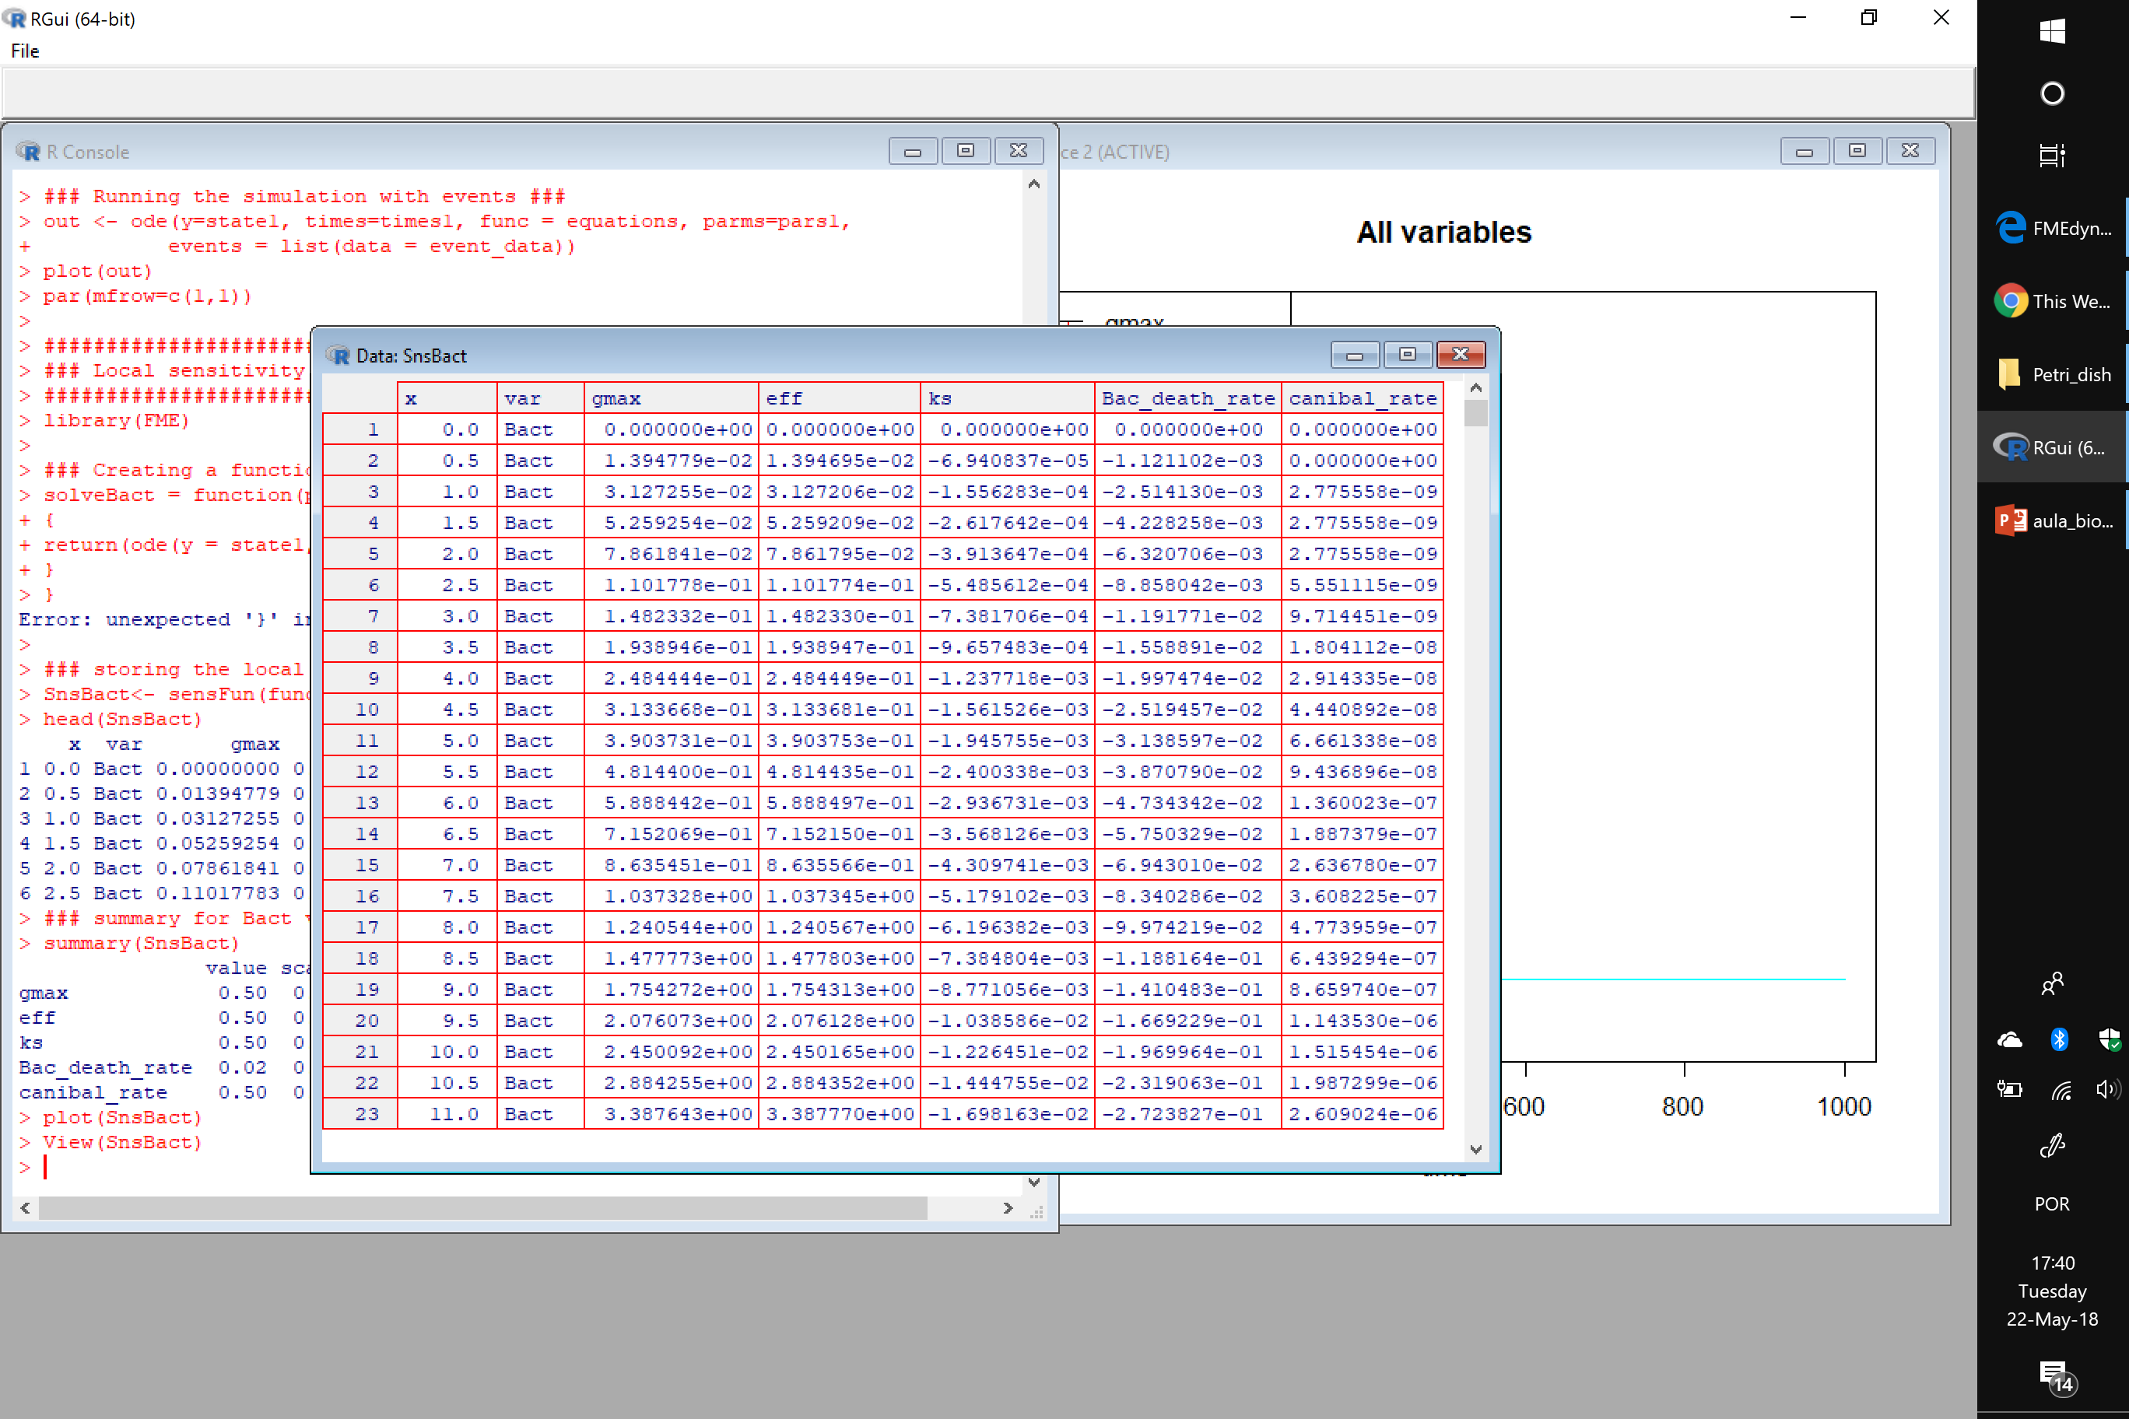
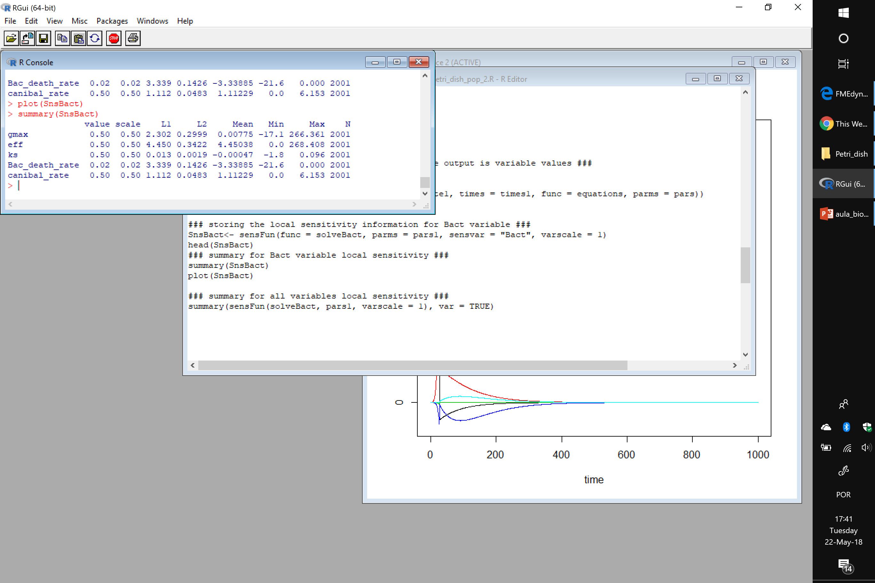
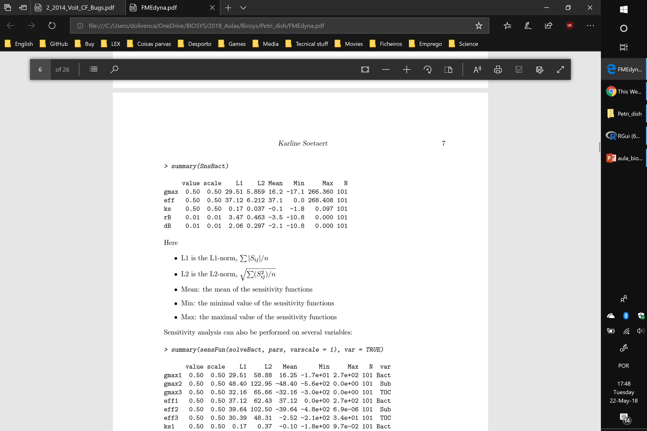
Local sensitivity

Slide 19
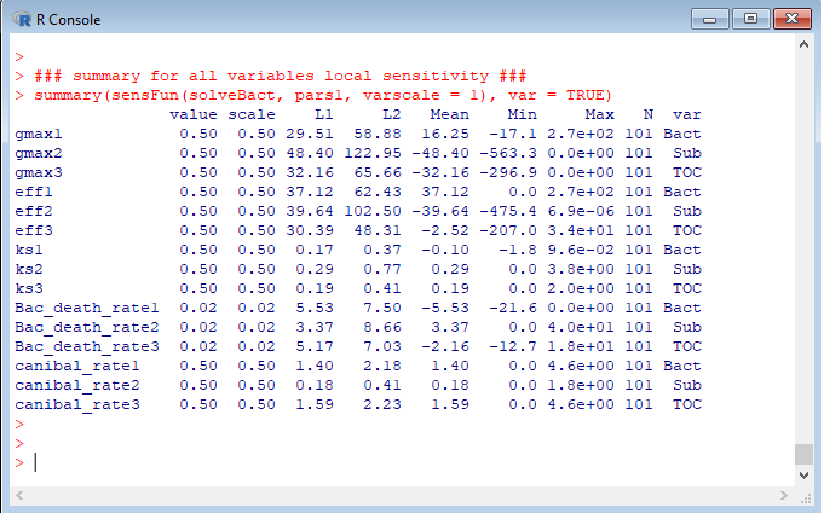
Local sensitivity

Slide 20
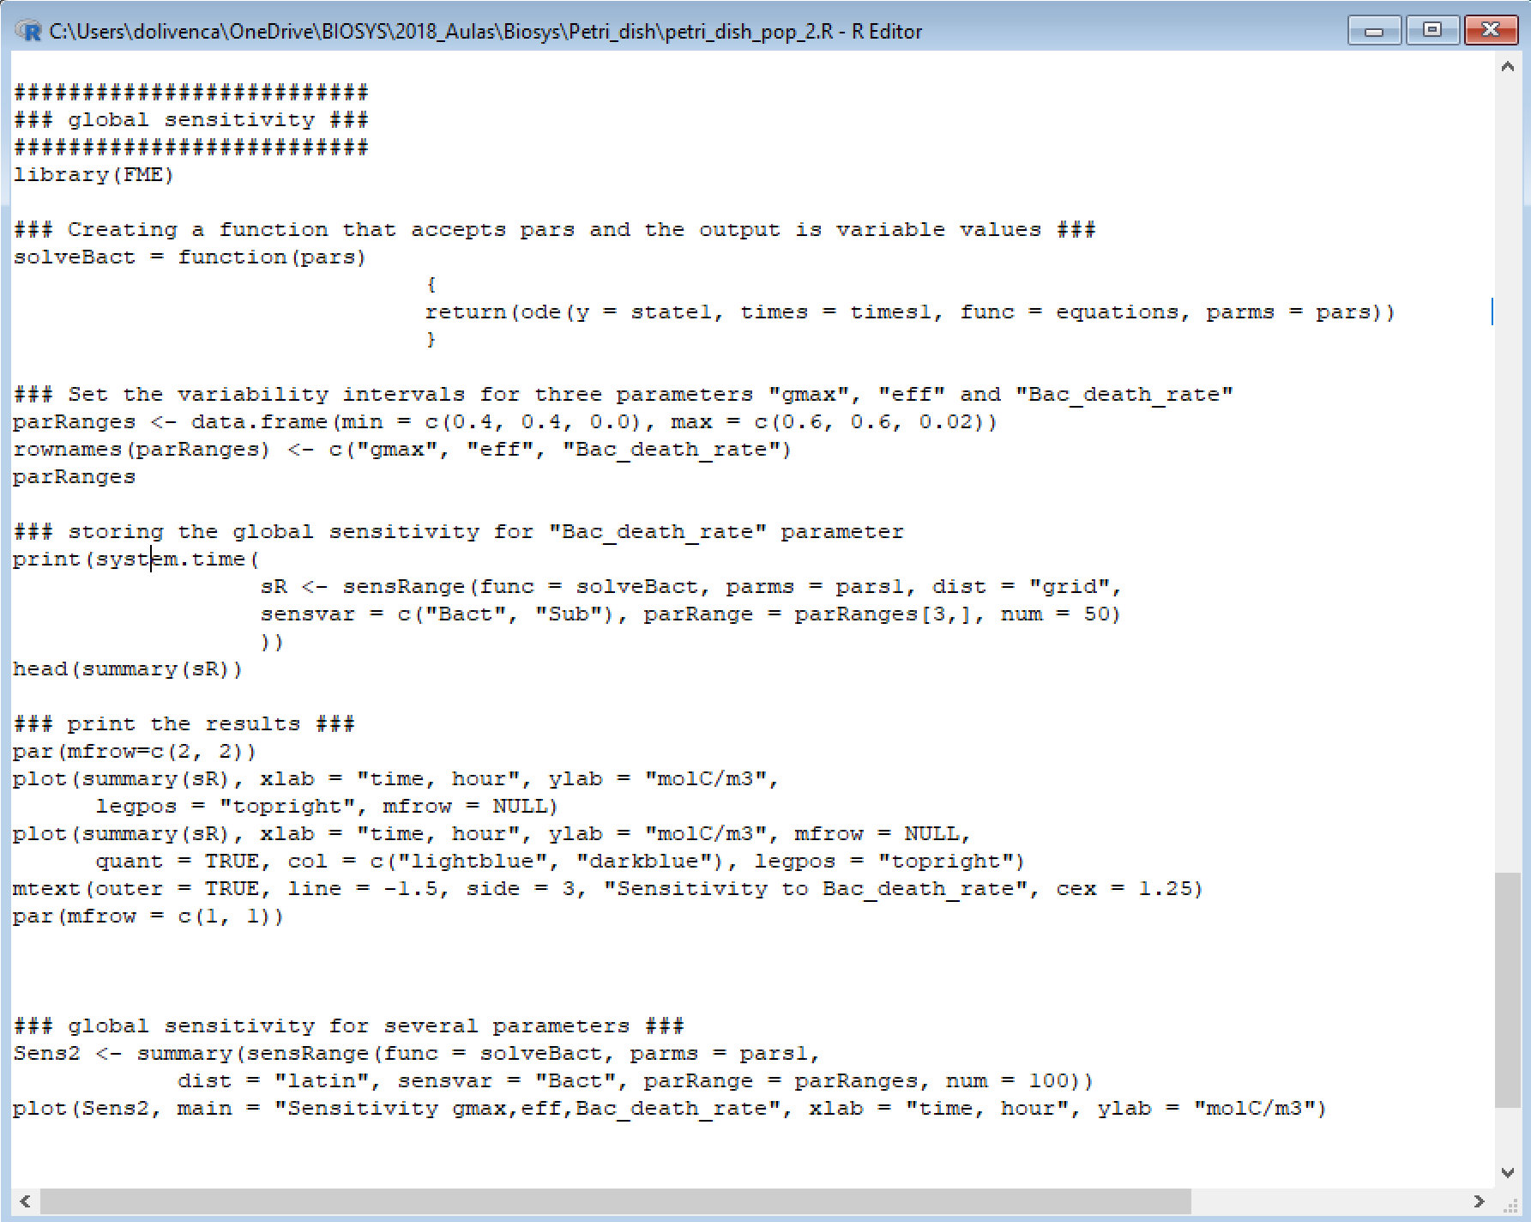
Global sensitivity

Slide 21
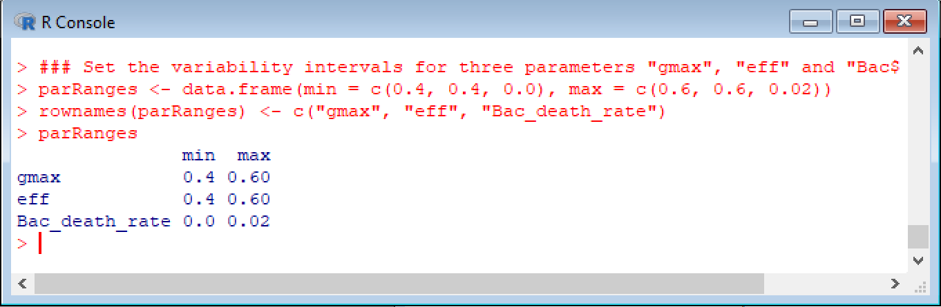
Global sensitivity

Slide 22
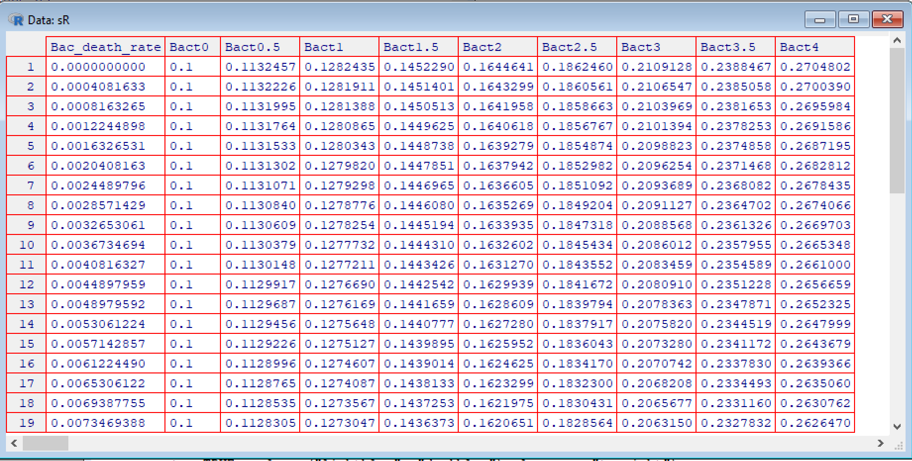
Global sensitivity

Slide 23
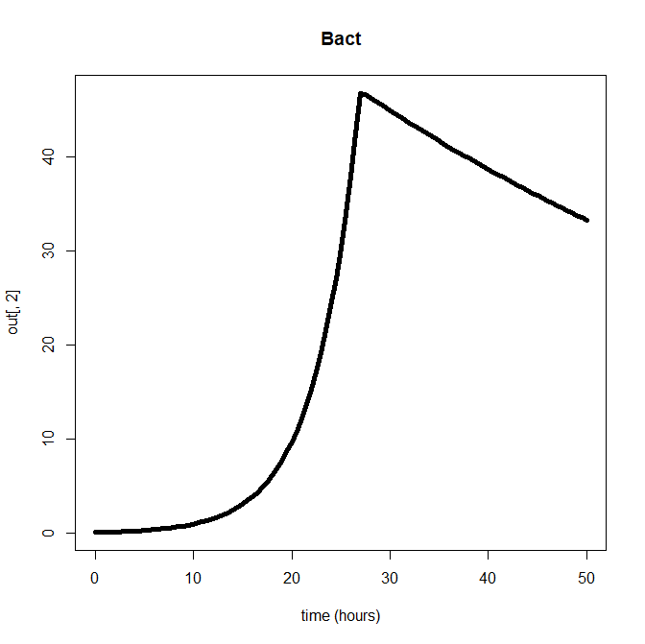
Global sensitivity

Slide 24
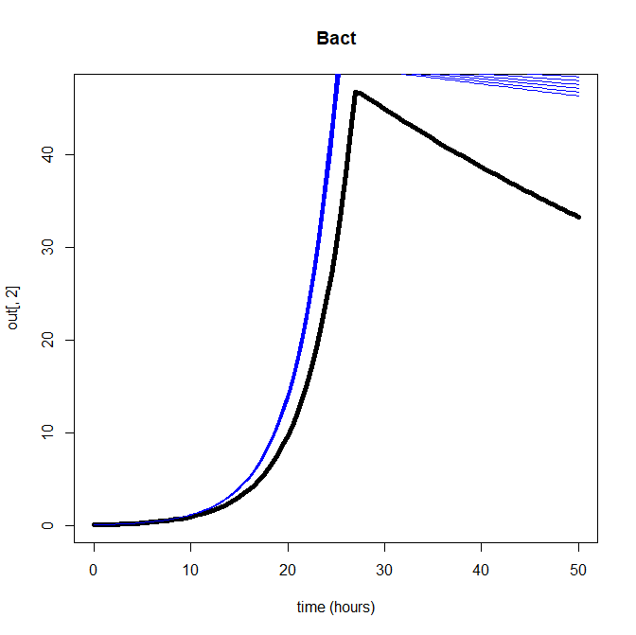
Global sensitivity

Slide 25
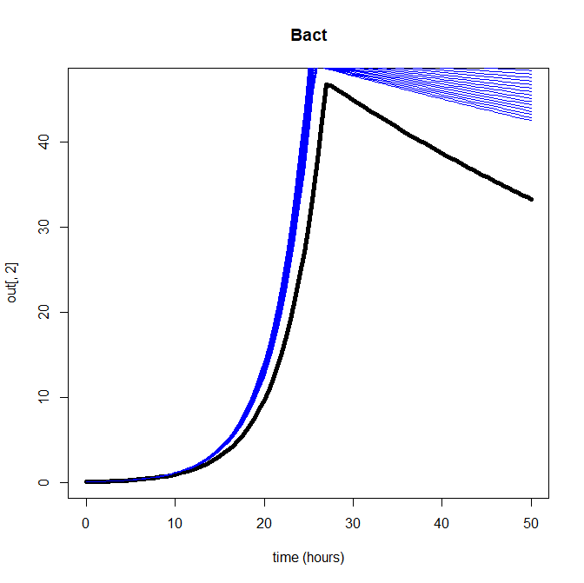
Global sensitivity

Slide 26
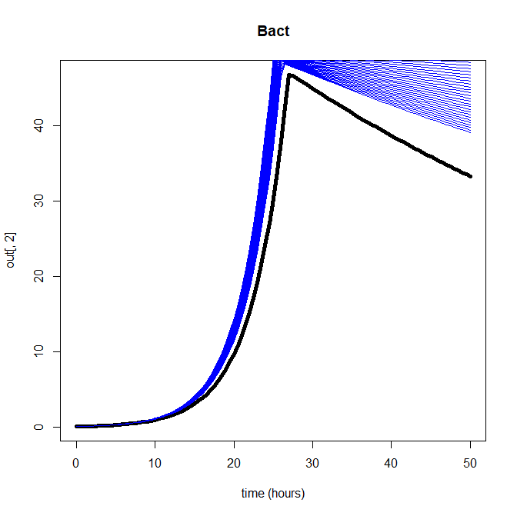
Global sensitivity

Slide 27
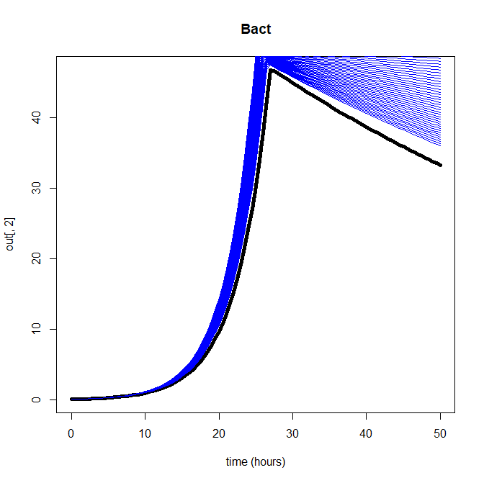
Global sensitivity

Slide 28
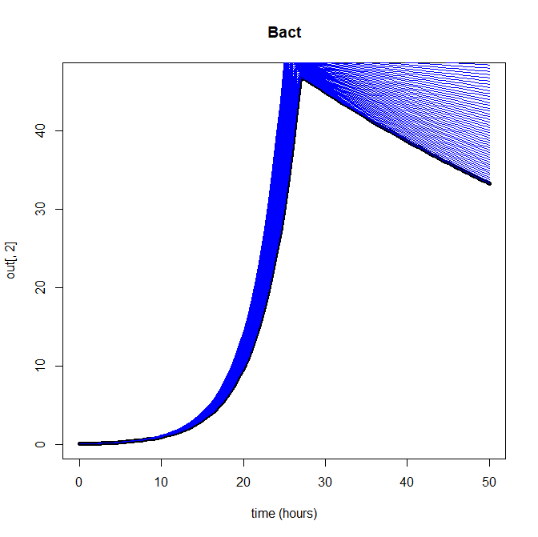
Global sensitivity

Slide 29
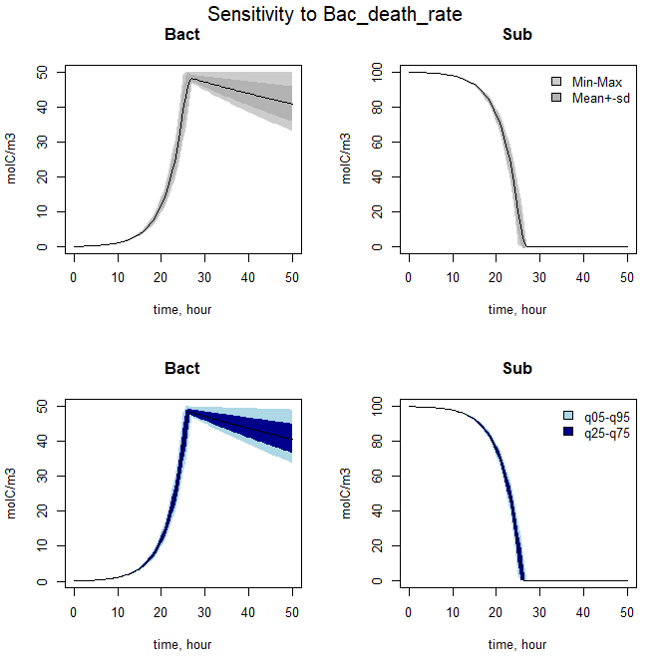
Global sensitivity

Slide 30
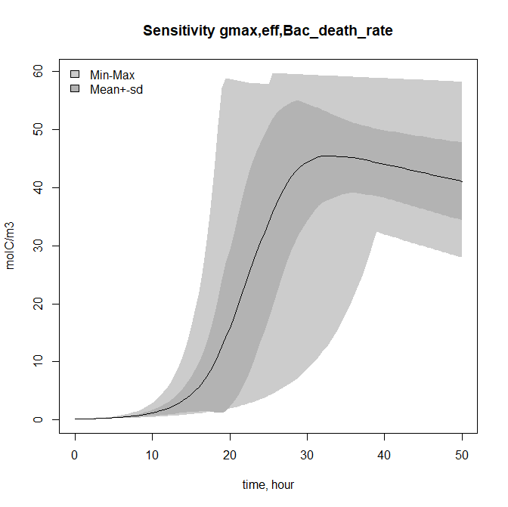
Global sensitivity

Slide 31
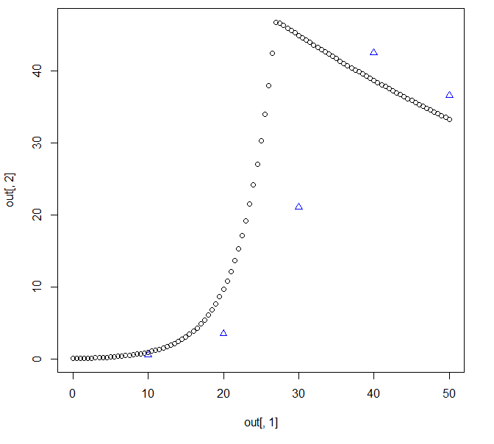
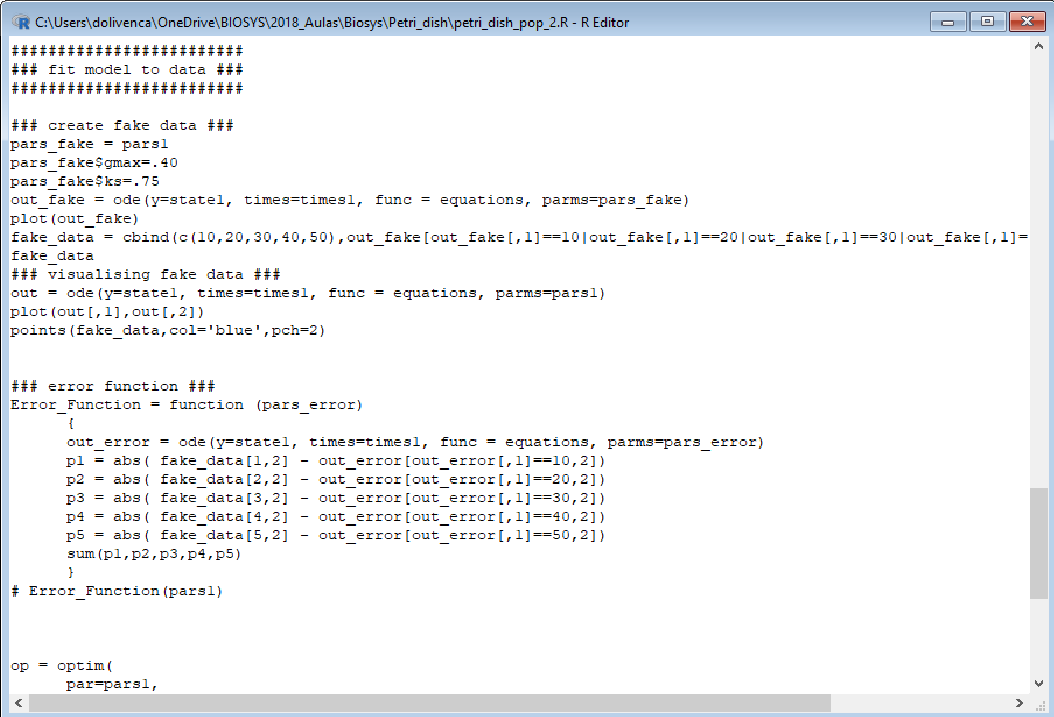
Fit model to data

Slide 32
Fit model to data

Slide 33
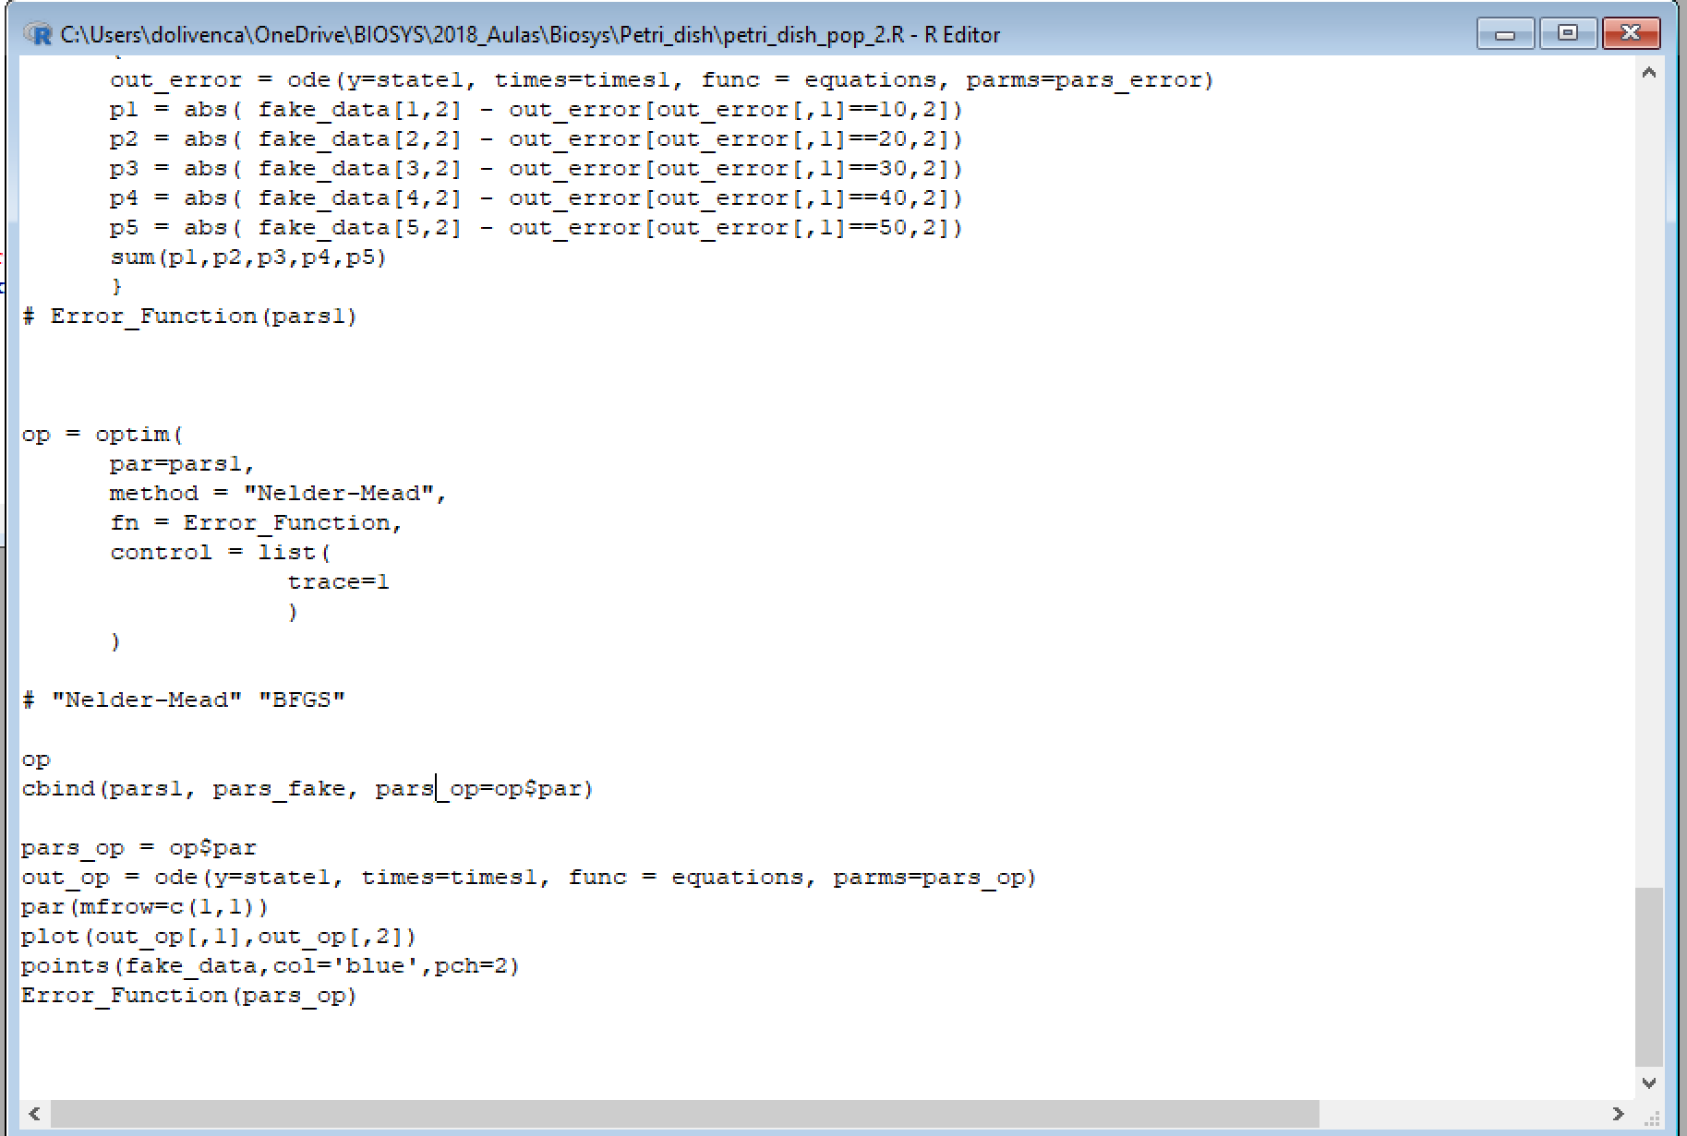
Fit model to data

Slide 34
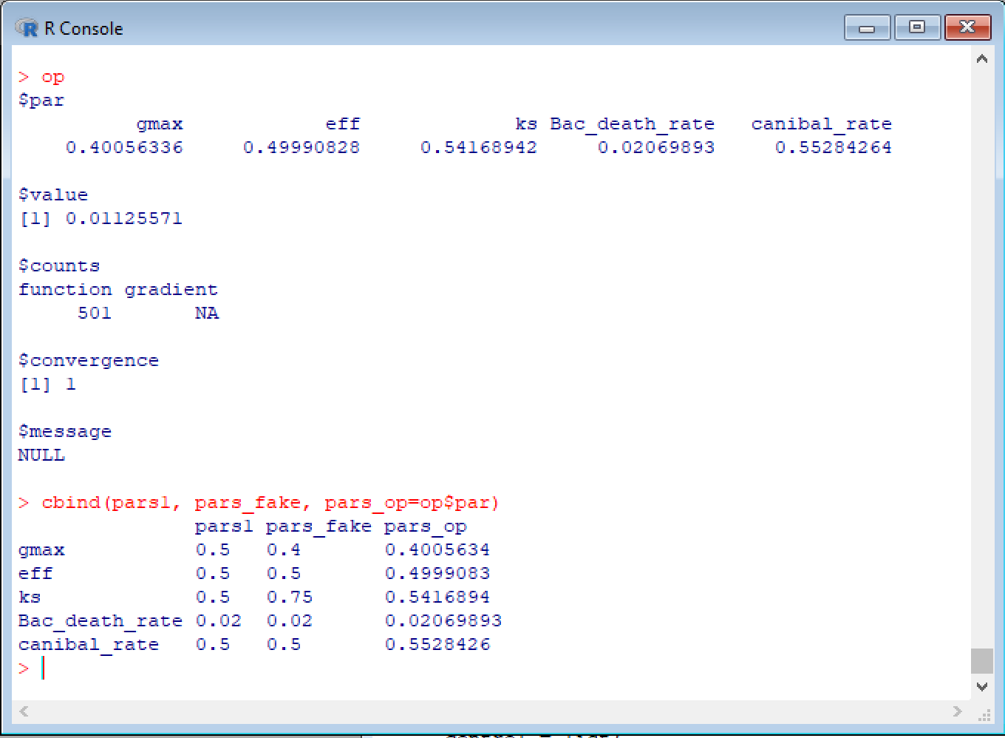
Fit model to data

Slide 35
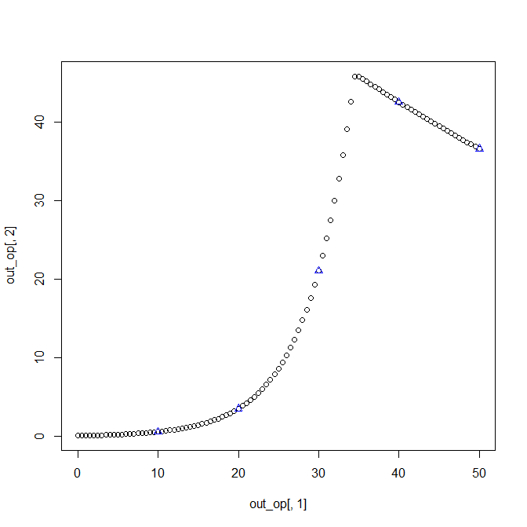
Fit model to data

Slide 36
General-purpose optimization - Nelder-Mead
Error function
Local minimum
Local minimum
Global minimum
Parameter values

Slide 37
General-purpose optimization - Nelder-Mead
Error function
Local minimum
Local minimum
Global minimum
Parameter values

Slide 38
General-purpose optimization - Nelder-Mead
Error function
Local minimum
Local minimum
Global minimum
Parameter values

Slide 39
General-purpose optimization - Nelder-Mead
Error function
Local minimum
Local minimum
Global minimum
Parameter values

Slide 40
Monte Carlo sampling
Error function
Local minimum
Local minimum
Global minimum
Parameter values

Slide 41
Monte Carlo sampling
Error function
Local minimum
Local minimum
Global minimum
Parameter values

Slide 42
Genetic algoritm
Error function
Local minimum
Local minimum
Global minimum
Parameter values

Slide 43
Genetic algoritm
Error function
Local minimum
Local minimum
Global minimum
Parameter values

Slide 44
Genetic algoritm
Error function
Local minimum
Local minimum
Global minimum
Parameter values

Slide 45
Genetic algoritm
Error function
Local minimum
Local minimum
Global minimum
Parameter values

Slide 46
Genetic algoritm
Error function
Local minimum
Local minimum
Global minimum
Parameter values

Slide 47
Genetic algoritm
Error function
Local minimum
Local minimum
Global minimum
Parameter values

Slide 48
Genetic algoritm
Error function
Local minimum
Local minimum
Global minimum
Parameter values

Slide 49
Genetic algoritm
Error function
Local minimum
Local minimum
Global minimum
Parameter values

Slide 50
Genetic algoritm
Error function
Local minimum
Local minimum
Global minimum
Parameter values

Slide 51
References:
Soetaert, K. (2002). R Package FME : Inverse Modelling, Sensitivity, Monte Carlo – Applied to a Dynamic Simulation Model.
https://cran.r-project.org/web/packages/FME/vignettes/FMEdyna.pdf
Voit, E. O. (2000). Computational analysis of biochemical systems: a practical guide for biochemists and molecular biologists. Cambridge, U.K.: Cambridge University Press.
Voit, E. O. (2013). Biochemical systems theory: a review. ISRN Biomathematics, 2013, 1–53.
https://doi.org/10.1155/2013/897658
Voit EO. (2013). A first course in systems biology. Garland Science,Taylor & Francis Group.
Further readings:
Voit EO. (2014). Mesoscopic modeling as a starting point for computational analyses of cystic fibrosis as a systemic disease. Biochim. Biophys. Acta - Proteins Proteomics.
http://www.ncbi.nlm.nih.gov/pubmed/23570976

